Slide 1

HOUSING TIME SERIES ANALYSIS

Slide 2

Group 8 Members
Sammy Sifuna
Julius Charles
Waruchu Kuria
Rael Ndonye
Alan Omondi
Janet Khainza

Slide 3
1
7
Business Understanding
Recommendations
outline
6
2
Conclusion
Data Understanding
5
3
Evaluation
Data Preparation
4
Modeling

Slide 4

Overview
Market Transformation: Initial rise in home prices driven by real estate's perceived long-term value and a decline of home values due to the Great Recession diminishing buyers trust.
Restored Stability: After the recession, stability was restored due to low interest rates as well as urbanization and technology which attracted younger dwellers to cities.

Slide 5

Business Problem
Waridi financial Investment firm has a big decision to make on the best 5 zip codes to invest on short-term basis.
Analyze median monthly housing sales prices for over 14,000 United States zip codes and find the best return on investment with tolerable risk.
Calculating 22-year, 5-year and 3-year ROI to figure out the best zip codes giving the most profit.

Slide 6

To determine the top 5 zip codes that show the highest potential return on investment (ROI) in 5 years.
To identify which top 5 states have the highest ROI.
To determine the best month to sell property to maximize ROI.

Slide 7

Data Understanding
Median monthly housing sales prices data for 265 zip codes in the USA, over the period of April 1996 through April 2018.
Dataset contains 14,723 records and 272 variables
The features contain a mix of numerical and categorical variables
The data will be used for time series analysis to predict housing sales prices.

Slide 8

Data Preparation
Data cleaning including checking for duplicated rows, missing values, dropping unnecessary and renaming columns.
1
Data analysis involved selecting top 10 states based on domain knowledge of the best states to invest in.
2
Calculating Return on Investment (ROI) and Co-efficient of Variation(CV) to determine where to invest.
3
Created visualizations of ROI and CV in relations to states and zip codes as well as time to average home sales price
4

Slide 9
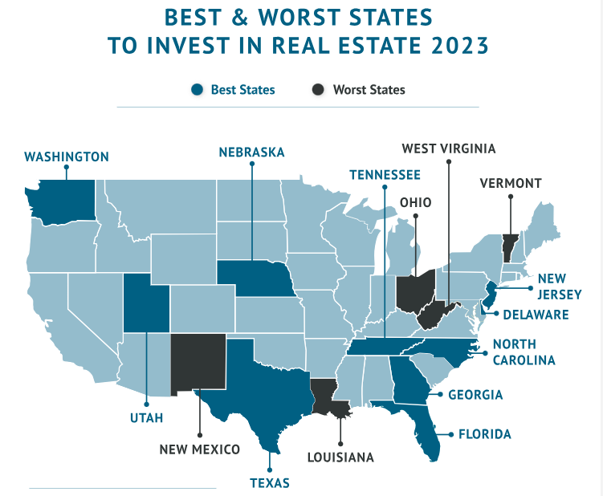
High population of renters
Demand for more housing
Low cost of living
High real estate market appreciation
Job opportunities
High happiness scores

Slide 10
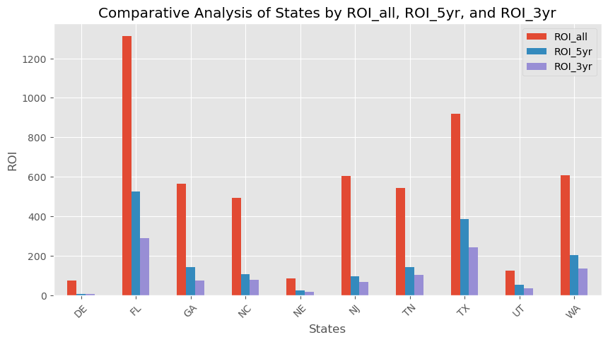
States VS ROI
State of Florida has the highest ROI for all specified periods.
Even though New Jersey comes third in 22-year ROI, it performs poorly in the 5-year and 3-year ROI
Delaware State has the lowest ROI values for all periods.

Slide 11
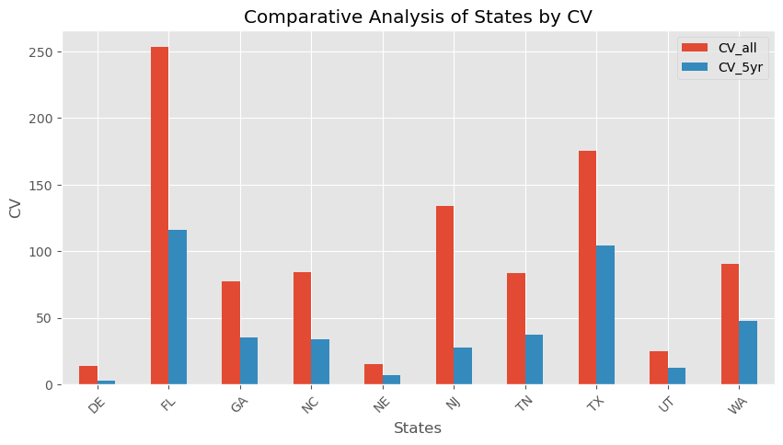
States VS CV
Again, Florida State has the highest Co-efficient of Variation values meaning that though it has high return on investment it is also highly risky to invest.
Delaware has low returns and low risk.

Slide 12
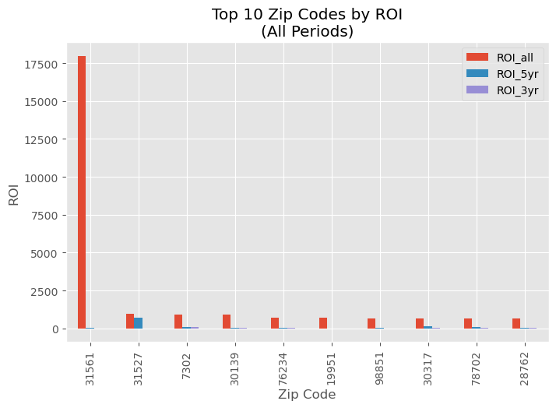
Zip codes VS ROI (all periods)
Zip Code 31561 (Sea Island, Georgia) seems to be performing extremely well in terms of potential for profits.
Zip Code 31527 (Jekyll Island, Georgia) has both considerably higher historic and 5-year ROI
3-year investment does not show so much significant ROI

Slide 13
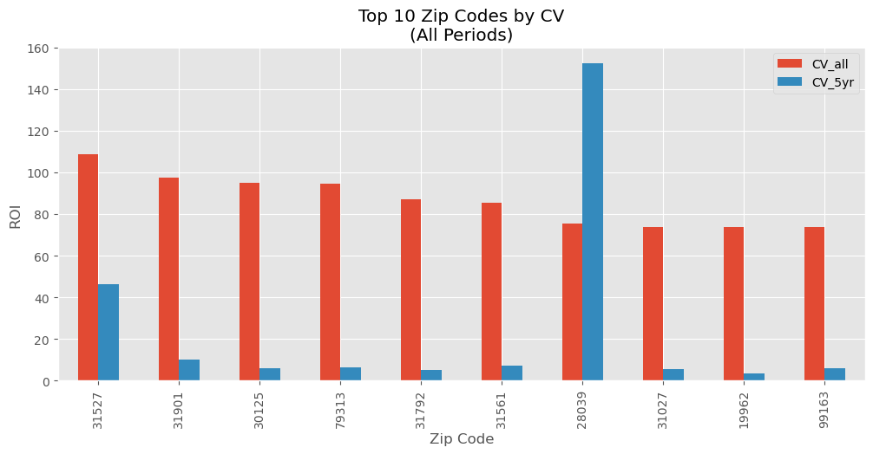
Zip codes VS CV (all periods)
Zip code 28039 (East Spenser, North Carolina) has the highest CV for the past five years, meaning that it has high risk of investment.
31527 (Jekyll Island, Georgia) has the highest historical overall CV.
The following have the least CV in the 5-year period.
i) 19962 (Magnolia, Delaware)
ii) 31792 (Thomasville, Georgia)
iii) 30125 (Cedartown, Georgia)
iv) 99163 (Pullman, Washington)
v) 79313 (Anton, Texas)

Slide 14
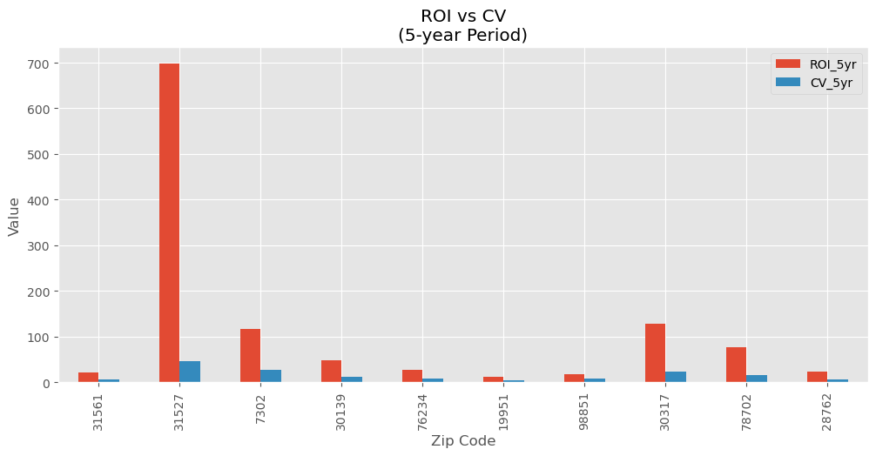
5-year (ROI and CV)
31527 ((Jekyll Island, Georgia) stands out again with a high 5-year ROI and CV.
7302 (Jersey City, New Jersey), 30317 (Atlanta, Georgia) and 78702 (Austin Texas) have high ROIs but higher than most CV values.
The visualization gives a good comparable visualization and was used to form the time series for modelling.

Slide 15
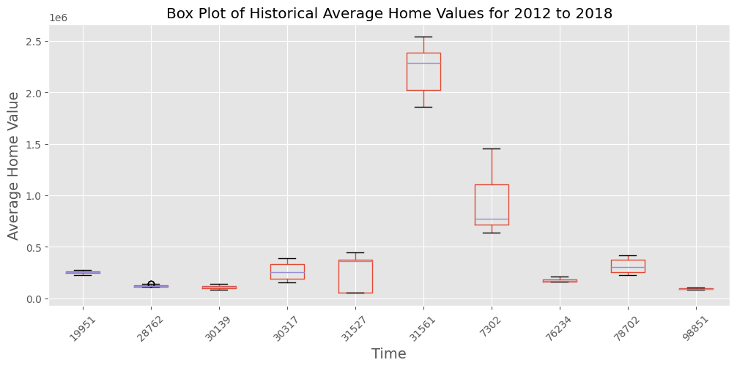
Average Home Value per Zip code
31561 (Sea Island, Georgia) and 7302 (Jersey City, New Jersey) have the highest average home values.
The two seem to be outliers.

Slide 16
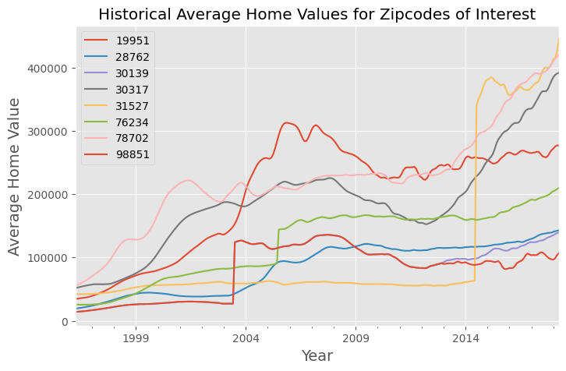
Average housing price vs Time
Time series analysis shows an upward trend from 2012 onwards.
There is a general decline in the average housing sales price from 2008 to 2012.

Slide 17

TIME SERIES MODELING
Model used past home sale values to predict future sales.
Sampled the top 10 zip codes based on ROI and CV
Revealed the top 5 zip codes based on RMSE and AIC metrics
Used SARIMAX and Facebook Prophet models

Slide 18

PREDICTIONSAND FORECASTING
While both models performed the same predictions and metric calculations, Facebook Prophet model was able to forecast the time series well.
The top five zip codes are visualized in the next slides.

Slide 19
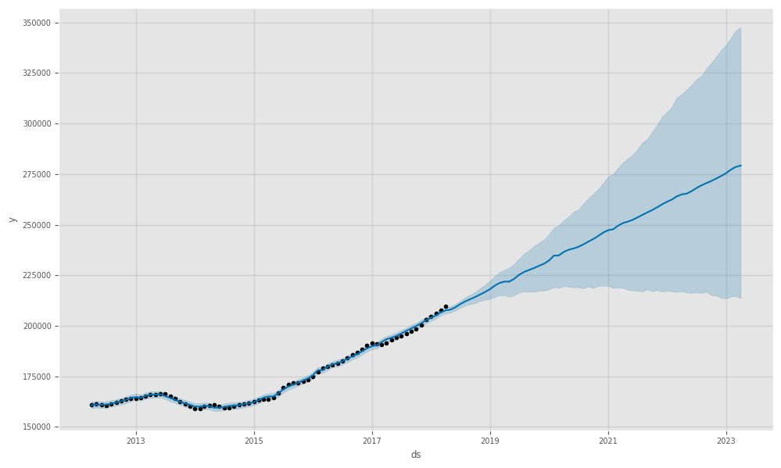
1. Decatur, Texas

Slide 20
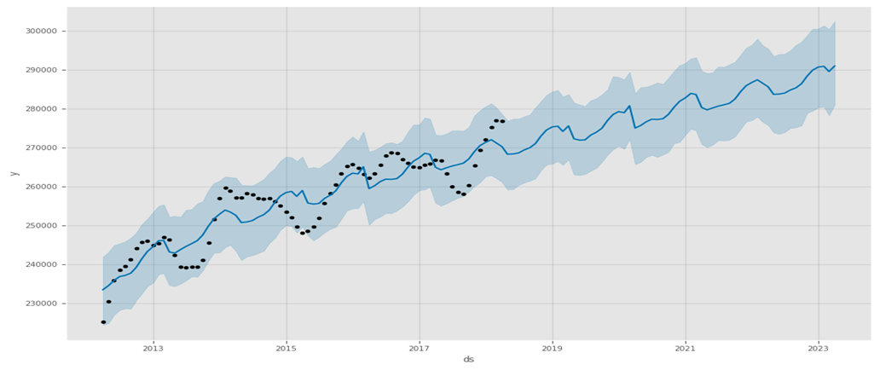
2. Harbeson, Delaware

Slide 21
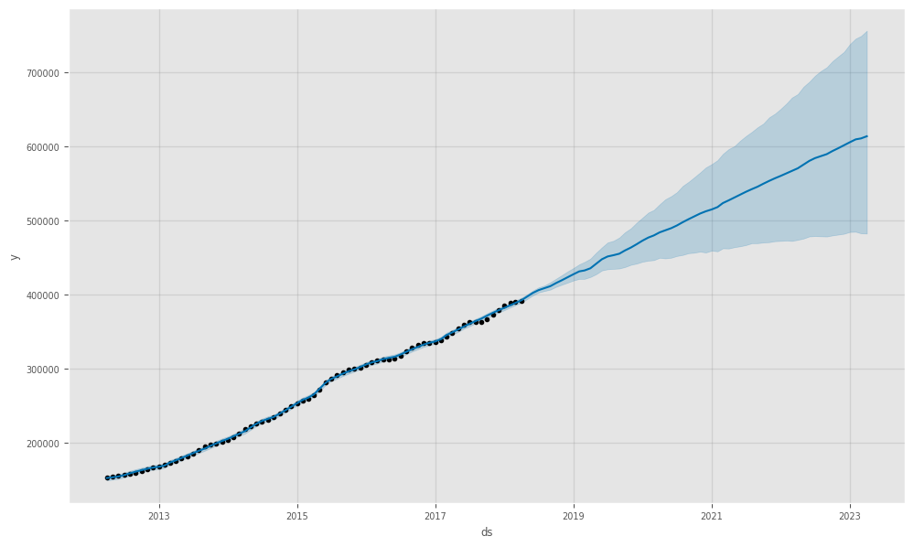
3. Atlanta, Georgia

Slide 22
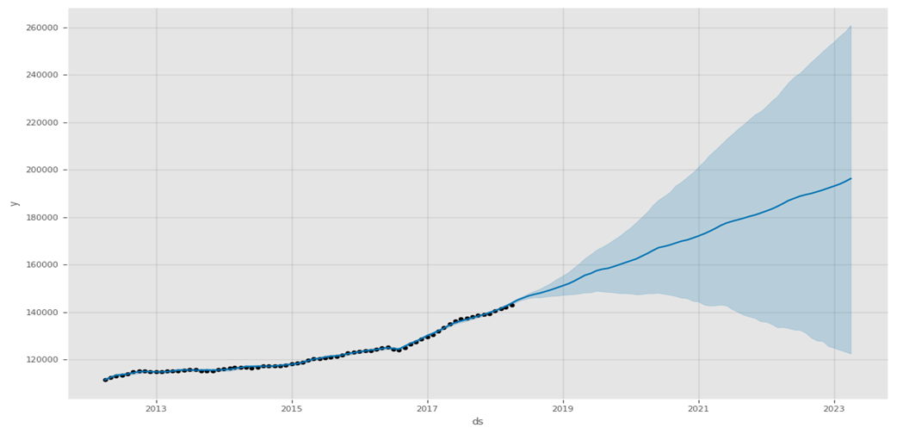
4. Old Fort, North Carolina

Slide 23
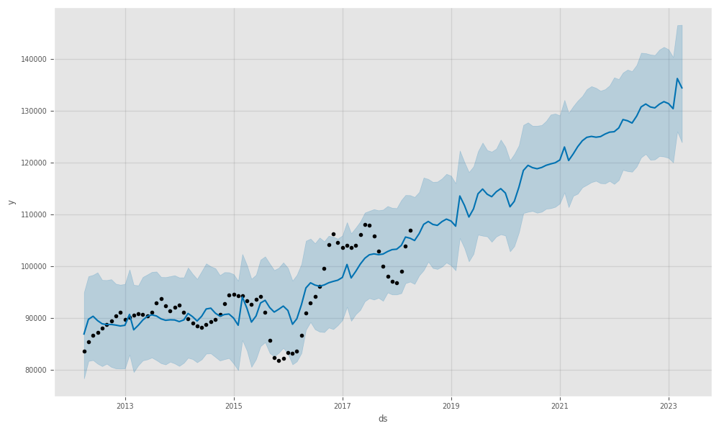
5. Soap Lake, Washington

Slide 24
Model Evaluation
 | RMSE | AIC
Decatur, TX | 5033.433673 | 765.971035
Harbeson, DE | 5753.477978 | 912.078435
Atlanta, GA | 6154.167274 | 892.355686
Old Fort, NC | 6779.883346 | 692.602794
Soap Lake, WA | 10254.866297 | 875.084354
Austin, TX | 11318.298431 | 1006.814736
Fairmount, GA | 13161.083951 | 835.732403
Jekyll Island, GA | 30178.717667 | 1201.778543

Slide 25

Conclusion
76234(Decatur, TX), 19951 ( Harbeson, DE), 30317 (Atlanta, GA), 28762 (Old Fort, NC) and 98851 (Soap Lake, WA) are top 5 zip codes to invest in because of high ROI and recourses should be put in them.
The best months to sell to maximize profit are:
December in Harbeson, DE,
April in Old Fort, NC and Fairmount, GA
June in Decatur, TX, Soap Lake, WA
Facebook prophet is a better model in predicting future housing sales values.
The return on investment and the risk are not necessarily correlated. Sometimes a high ROI could also mean a high risk and vice versa

Slide 26

RECOMMENDATIONS
Invest on the top 5 zip codes and allocate resources towards them.
Obtain current data after 2018 for current predictions
There is need to consider outside factors (housing grade, property size, renovations) that may also affect Sales value.

Slide 27


